Slide 1
Question 5
Presented by jamil rayhan
Id:18cse061

Slide 2
question
Implement of a circuit with PLA having 3 inputs, four product terms and two outputs for the following functions:
F₁(A,B,C)= ∑(0,1,2,4)
F₂(A,B,C)= ∑(0,5,6,7)

Slide 3
K-map for f₁
A\BC | 00 | 01 | 11 | 10
0 | 1 | 1 | 0 | 1
1 | 1 | 0 | 0 | 0
True value of F₁=(A’B’+B’C’+A’C’)
Complement of F₁’=(AC+AB+BC)

Slide 4
K-map for f₂
A\BC | 00 | 01 | 11 | 10
0 | 1 | 0 | 0 | 0
1 | 0 | 1 | 1 | 1
True value of F₂=AC+AB+A’B’C’
Complement of F₂’=A’C+A’B+AB’C’

Slide 5
Minterms | Variable |  |  | Output
 | A | B | C | F₁’(C) | F₂(T)
AC | 1 | - | 1 | 1 | 1
AB | 1 | 1 | - | 1 | 1
BC | - | 1 | 1 | 1 | -
A’B’C’ | 0 | 0 | 0 | - | 1

Slide 6
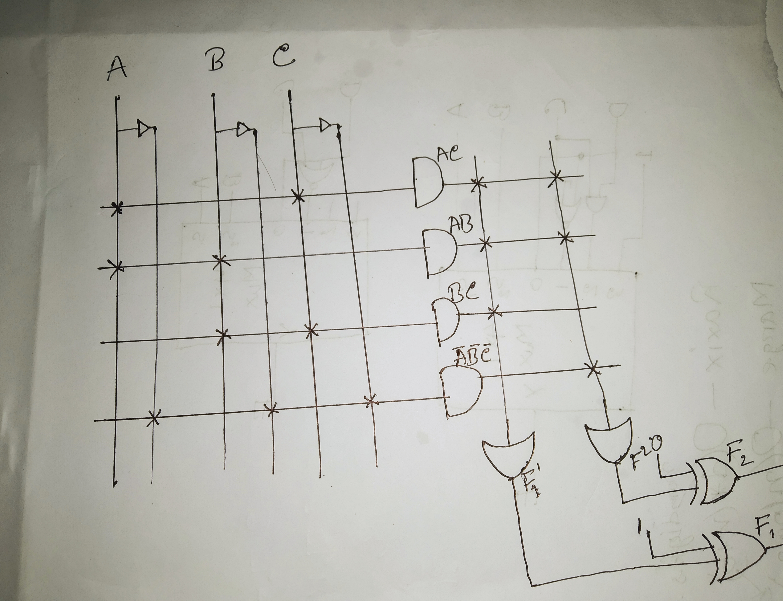
Circuit diagram

Slide 7
Thank You

